Slide 1

Dipesh Khadgi
Dipesh Tha Shrestha
Rasik Shrestha
Rijan Prajapati

Slide 2
SRS Document
Design Document
Documentation

Slide 3
INTRODUCTION
The 4 college friend sat together to plan and introduce a new Television Broadcasting System. The main objective of this project was to bring a reliable, trustworthy, and genuine streaming service all over Nepal.
Task Division:
Dipesh Tha Shrestha: SRS Documentation
Dipesh Khadgi: Three tier architecture/ Sequence Diagram/ ER diagram
Rasik Shrestha: Website Design
Rijan Prajapati: Deployment And AMC

Slide 4
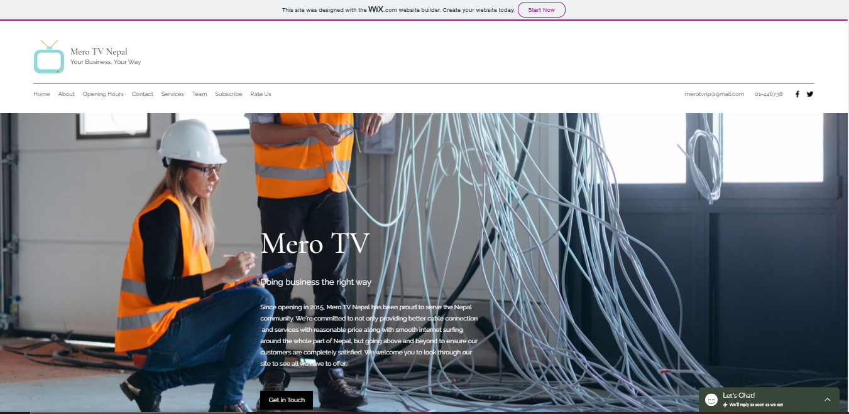

Slide 5
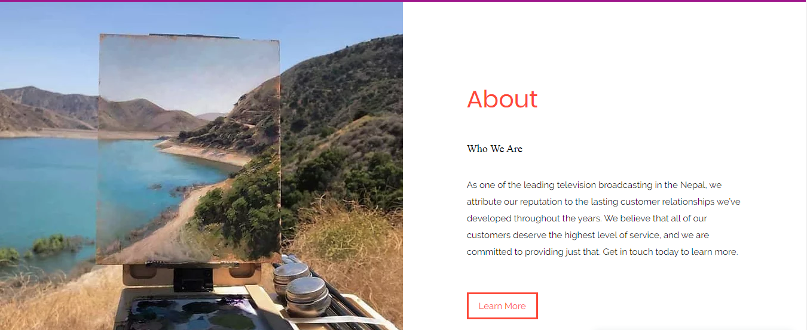

Slide 6
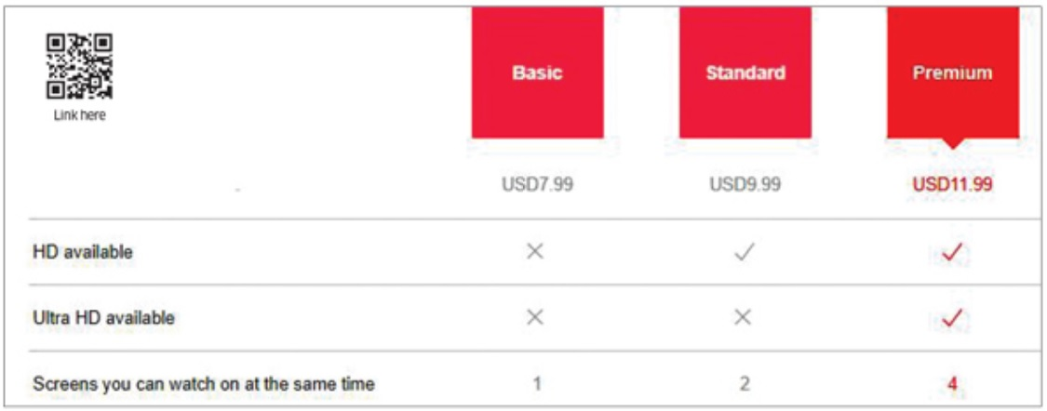
Services

Slide 7
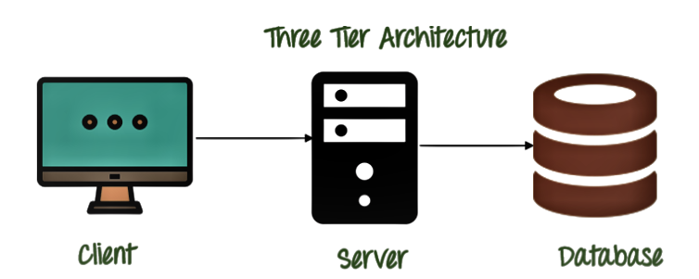

Slide 8
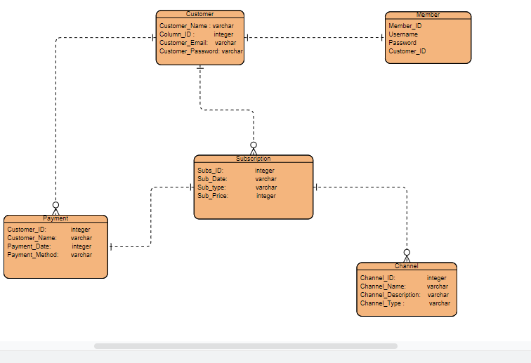

Slide 9
Thank YOU

